Slide 1
X16 - Multivariate Methods and Image-processing for Quantitative Microscopy Spectral Unmixing Methods
Rama Vasudevan
Microscopy and Microanalysis 2018
Baltimore, MD
August 5th 2019

Slide 2
Spectral Data
Many imaging modalities have spectroscopy components
By capturing spectra across an image, it allows us to correlate features of the spectra with specific regions of the sample
Spectrum at individual pixel
Image (MxN pixels)
Response
Spectroscopic axis
M (rows) x N (columns) x P (spectral points)

Slide 3
Spectral Data
Many imaging modalities have spectroscopy components
By capturing spectra across an image, it allows us to correlate features of the spectra with specific regions of the sample
P
Image (MxN pixels)
(Repeat MxN matrix P times to make 3D cube)

Slide 4
Spectral Data
Examples include EELS, micro Raman imaging, force-distance curve maps in AFM, Scanning tunneling spectroscopy, etc.
Usually, the 3D matrix is converted to a 2D matrix
M (rows) x N (columns) x P (spectral points)
= (MN) x P
Pixels x spectral points
P
MN

Slide 5
Matrix Factorization
We now have a 2D matrix (call it X) of size (MN,P)
If X is ‘small’ (e.g., (10,10)) we can comprehend it easily. But if the size of X is (2500, 32), then this becomes more difficult
The number of spectral points P is often termed the “number of dimensions”.
To see trends in our data, we want to visualize them in some manner. But the 3D data cube is big, so what can we do?
Matrix Factorization

Slide 6
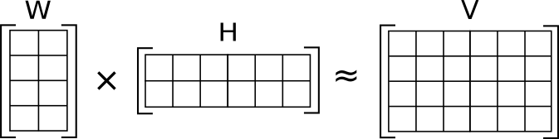
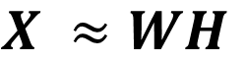
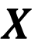
Dimensionality Reduction
The reason it is difficult to visualize is because there are too many spectral points P per pixel. What we need is to reduce the dimensionality, while preserving most of the data structure.
What if we could write our matrix X (size MN,P) as
$$X ≈WH$$
$$X$$
Where W is size (MN,R)
H is size (R,P)
R <P
(R)
(MN)
(P)
(R)
(MN,P)

Slide 7
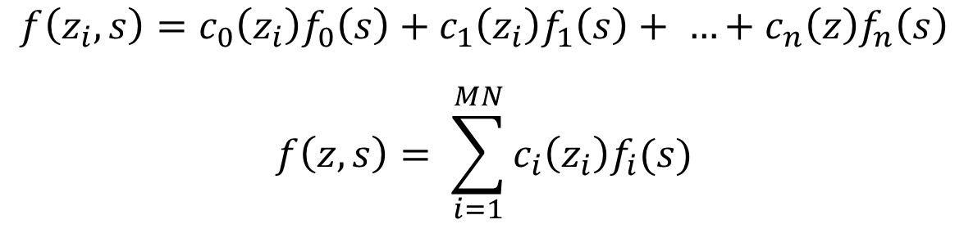
Dimensionality Reduction
The reason it is difficult to visualize is because there are too many spectral points P per pixel. What we need is to reduce the dimensionality, while preserving most of the data structure.
Alternative viewpoint: Represent the spectrum at pixel z by a linear expansion
$$f\left(z_{i}, s\right)=c_{0}\left(z_{i}\right)f_{0}\left(s\right)+c_{1}\left(z_{i}\right)f_{1}\left(s\right)+ …+c_{n}\left(z\right)f_{n}\left(s\right)$$
$$f\left(z,s\right)= \sum_{i=1}^{MN}{c_{i}\left(z_{i}\right)f_{i}(s)}$$
The task boils down to determining the functions f_{n}(s), and determining the coefficients c_{n}

Slide 8

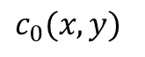
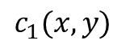
Dimensionality Reduction
The reason it is difficult to visualize is because there are too many spectral points P per pixel. What we need is to reduce the dimensionality, while preserving most of the data structure.
Alternative viewpoint: Represent the spectrum at pixel z by a linear expansion
$$c_{0}(x,y)$$
At a single pixel
f₀ (s)
Response
$$≈c_{0}f_{0}+c_{1}f1$$
$$c_{1}(x,y)$$
f₁ (s)
Spectroscopic axis

Slide 9
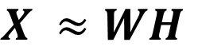
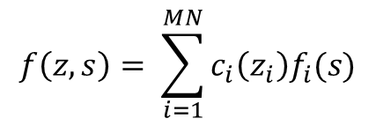
Dimensionality Reduction
Equation we are trying to solve
Matrix Form
Functional Form
$$f\left(z,s\right)= \sum_{i=1}^{MN}{c_{i}\left(z_{i}\right)f_{i}(s)}$$
$$X ≈WH$$
Note: Here assuming linear mixing
This problem can be solved if we add certain constraints. For example,
Insist that the functions f_{n} be orthogonal and ordered based on variance (Singular value decomposition)
Insist that the matrices W,H be non-negative (Non-negative Matrix Factorization)
Insist that the functions f_{n} be ‘independent’ (Independent Component Analaysis)
Certain regularizations (not covered here)

Slide 10
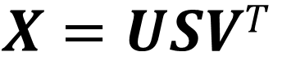
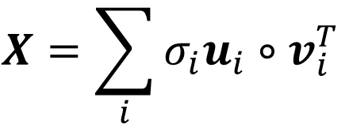

(1) Singular Value Decomposition
$$X=USVT$$
X is of size (m,n)
U is of size (m,r)
S is of size (r,r)
V is of size (n,r)
Note: In the full decomposition, r = n. Practically, r<<n
U is called “Left Singular Vectors”
S is a diagonal matrix of “Singular Values”
V is called “Right Singular Vectors”
n
X
$$≈$$
S
V^{T}
$$X=\sum_{i}{σ_{i}u_{i}}∘v_{i}^{T}$$
m
U

Slide 11
(1) Singular Value Decomposition
$$X=USVT$$
X is of size (m,n)
U is of size (m,r)
S is of size (r,r)
V is of size (n,r)
The columns of U,V form the basis
S scales them, in descending order
Note: In the full decomposition, r = n. Practically, r<<n
By the SVD theorem, it is always possible to decompose real matrix
X into USV^{T} where
U,S,V: unique
U,V: column orthonormal
U^{T}U =I, V^{T}V=I
Columns are orthogonal unit vectors
S: diagonal
- Positive, sorted in descending order
Finding the main ‘directions’ in the data

Slide 12
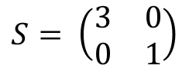
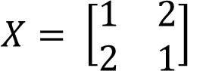
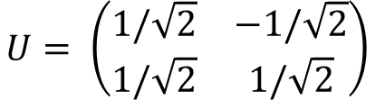
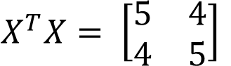

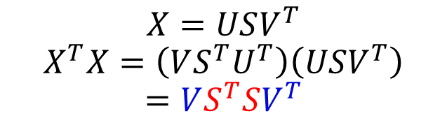
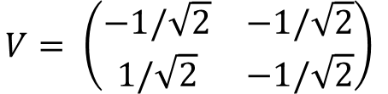
(1) Singular Value Decomposition
Example: SVD on a matrix X
Observe that
And also…
$$X=USV^{T}$$
$$X^{T}X=\left(VS^{T}U^{T}\right)\left(USV^{T}\right)$$
$$=VS^{T}SV^{T}$$
$$XV=USV^{T}V$$
$$XV=US$$
Eigenvectors
Eigenvalues
So now this is equivalent of finding the eigenvalues and eigenvectors of this X^{T}X matrix
$$X= \left[\begin{matrix}1 & 2 \\ 2 & 1\end{matrix}\right]$$
$$X^{T}X= \left[\begin{matrix}5 & 4 \\ 4 & 5\end{matrix}\right]$$
For fun: compute eigenvalues by hand via det(X^{T}X – λI)
Eigenvalues are 9,1
Which is s²
So s = 3,1
Find associated Eigenvectors, and finally you end up with…
$$U= \left(\begin{matrix}1/\sqrt{2} & −1/\sqrt{2} \\ 1/\sqrt{2} & 1/\sqrt{2}\end{matrix}\right)$$
$$S= \left(\begin{matrix}3 & 0 \\ 0 & 1\end{matrix}\right)$$
$$V= \left(\begin{matrix}−1/\sqrt{2} & −1/\sqrt{2} \\ 1/\sqrt{2} & −1/\sqrt{2}\end{matrix}\right)$$

Slide 13
Some notes
Finding eigenvalues of large matrices is much more difficult and is done numerically.
Note that ‘Principal Component Analysis’ is closely related to SVD, assuming that the matrix X is centered. In fact, one can convert the U,S,V matrices from SVD to principal components and scores easily, as US gives the scores and V gives the principal directions/axes.
We will explore singular value decomposition for a spectral dataset in the Jupyter notebook

Slide 14
(Jupyter Notebook)
Example on using SVD on an EELS dataset, via pycroscopy’s do_svd() algorithm.

Slide 15

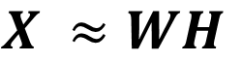
Non-negative Matrix Factorization
SVD is an extremely powerful tool to visualize data and observe trends, but it has weaknesses. Mainly, it often produces highly unphysical behavior, for instance negative intensity values in spectra where only positive values are physically realizable
Therefore, we can turn to other methods, such as non-negative matrix factorization approaches
Matrix Form
k
n
$$X ≈WH$$
X
k
m
Here, we enforce that X, W and H are all non-negative matrices
$$≈$$
k is called ‘low-rank’.
The positivity constraint often helps to make the factor matrices more interpretable.

Slide 16
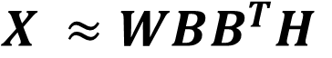
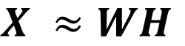
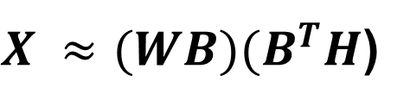
Non-negative Matrix Factorization
The downside: SVD has a unique decomposition, NMF does not. Why?
$$X ≈WH$$
Assume we have another matrix BB^{T} = I
Then, we can write
$$X ≈WBB^{T}H$$
$X ≈(WB{)(B}^{T}H$)
Therefore, we have now found new factors for the NMF decomposition.
But in reality, this can be alleviated by e.g. imposing more constraints such as sum-to-one, sparsity, etc.

Slide 17
(Jupyter Notebook)
Example on using NMF on an EELS spectroscopic dataset

Slide 18
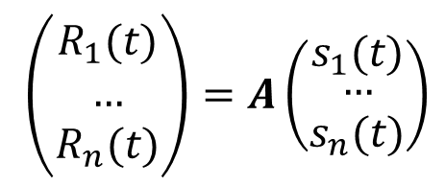
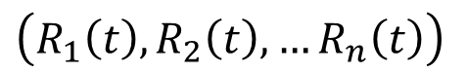
Independent Component Analysis
In some situations, we need to determine a constituent signal from a number of signals generated from independent sources
Example: Attempting to listen to one person when many other people are talking.
For example, if we have time series signals:
Then we wish to compute
ICA
$\left(\begin{matrix}R_{1}(t) \\ … \\ R_{n}(t)\end{matrix}\right)=A\left(\begin{matrix}s_{1}(t) \\ \begin{aligned}… \\ s_{n}(t)\end{aligned}\end{matrix}\right)$
$\left(R_{1}\left(t\right), R_{2}\left(t\right), …R_{n}\left(t\right)\right)$
We need to specify the number of signals n
The algorithm proceeds to find the signals and the mixing coefficients, such that the ‘independence’ is maximized. Independence of components can be enforced by maximum non-Gaussianity in estimated components, or minimization of mutual information (KL divergence, etc.).

Slide 19
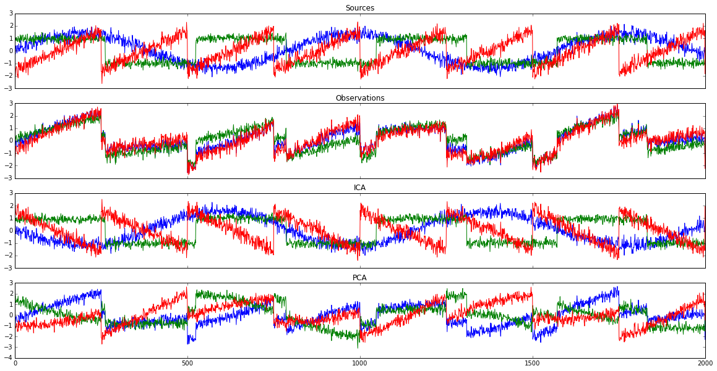
Independent Component Analysis
Simple toy problem from scikit-learn

Slide 20
(Jupyter Notebook)
Example on using ICA on EELS spectroscopic dataset.

Slide 21
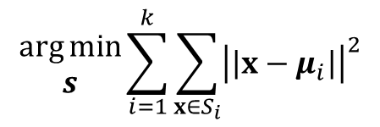
K-Means Clustering
SVD, NMF and ICA are decompositions. But sometimes, we don’t want to decompose our signal, but just group them into ‘alike’ sets.
This is termed ‘clustering’. The easiest and most widely used method is the k-means algorithm
K-means Clustering algorithm, to separate data (x₁,x₂,…,x_{n}) into k clusters
$$\begin{matrix}\arg{min} \\ s\end{matrix}\sum_{i=1}^{k}{\sum_{x∈S_{i}}{{\left|\left|x−μ_{i}\right|\right|}^{2}}}$$
where µ_{i} is the mean of points in S_{i}
(Determine S = {S₁,S₂,…S_{k}}, such that within cluster sum of squares is minimized)

Slide 22
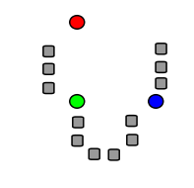
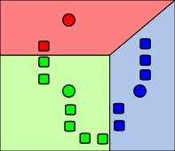
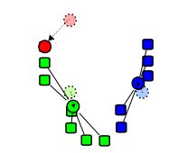
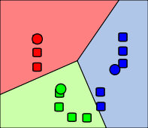
K-Means Clustering
How the algorithm works (k=3 shown)
Step 1
Step 2
Step 3
Step 4
Initialization: randomly generate 3 ‘means’
Assign each datapoint to a cluster based on nearest mean
Determine centroid of cluster, and use as the new mean
Repeat 2,3 until convergence
Source: Wikipedia

Slide 23

K-Means Clustering
Source: Wikipedia

Slide 24
(Jupyter Notebook)
Example on using Kmeans on a EELS Dataset.

